Slide 1
JDBC
Java DataBase Connectivity

Slide 2
What is JDBC?
JDBC stands for Java Database Connectivity, which is a standard Java API for database-independent connectivity between the Java programming language and a wide range of databases.

Slide 3
JDBC Vs ODBC
ODBC is for Microsoft and JDBC is for java applications.
ODBC can't be directly used with Java because it uses a C interface.
ODBC makes use of pointers which have been removed totally from java.
ODBC requires manual installation of the ODBC driver manager and driver on all client machines.JDBC drivers are written in java and JDBC code is automatically installable, secure, and portable on all platforms.

Slide 4
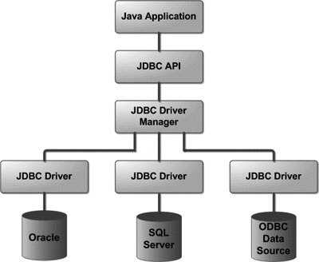
JDBC Architecture

Slide 5
JDBC Drivers Types

Slide 6
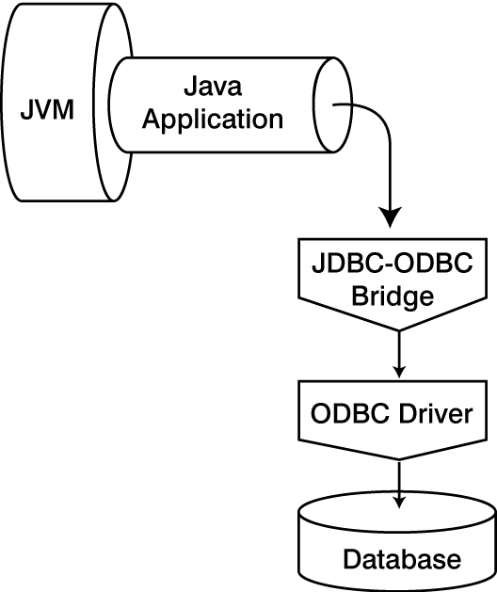
Type 1: JDBC-ODBC Bridge Driver

Slide 7
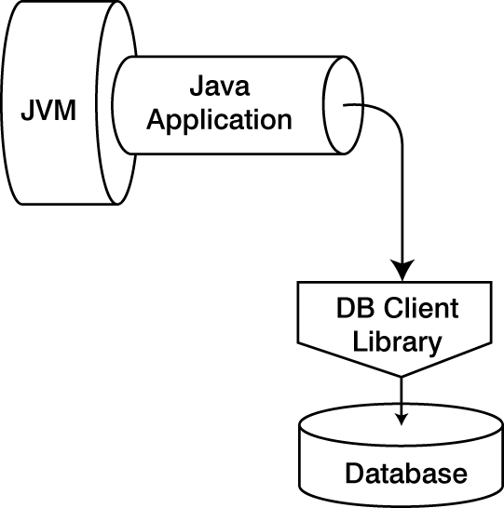
Type 2: partial Java drivers

Slide 8
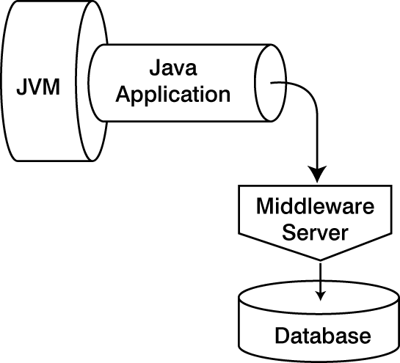
Type 3: JDBC-Net Protocol Driver

Slide 9
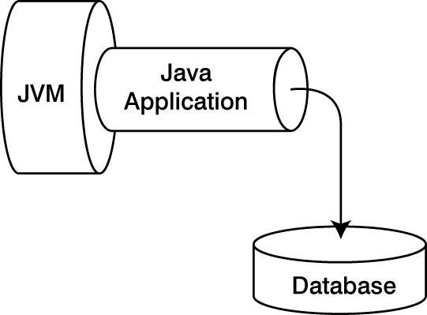
Type: 4 Pure Java Driver

Slide 10
Steps to use JDBC in Java
1. Import java package
2. Loading a database driver
3. Creating a Connection
4. Creating a Statement
5. Executing a SQL statement
6. Getting Results
7. Closing Database Connection

Slide 11
Steps to use JDBC in Java cont....
1. Import the package
import java.sql.*;
2. Loading a database driver
Class.forName("oracle.jdbc.driver.OracleDriver");
3. Creating a Connection
Connection cn=DriverManager.getConnection(url, ”loginName”,”Password”)

Slide 12
Steps to use JDBC in Java cont...
4. Creating a Statement
Statement st=cn.createStatement();
5. Executing a SQL statement
st.executeQuery( "SELECT * FROM employee" );
6. Getting Results
ResultSet rs = st.executeQuery();
7. Closing Database Connection
rs.close();
cn.close();

Slide 13
Create Tables Example
import java.sql.*;
public class Main {
public static void main(String args[])throws Exception {
Class.forName("oracle.jdbc.driver.OracleDriver");
Connection cn=DriverManager.getConnection("jdbc :oracle:thin:@localhost:1521:xe", "valan","valan");
Statement st=cn.createStatement();
st.executeQuery("create table table1(name varchar(20),age int)");
st.close(); } }

Slide 14
Insert Query
import java.sql.*;
public class Main {
public static void main(String args[])throws Exception {
Class.forName("oracle.jdbc.driver.OracleDriver");
Connection cn=DriverManager.getConnection("jdbc:oracle: thin:@localhost:1521:xe", "valan","valan");
Statement st=cn.createStatement();
st.executeQuery("insert into table1 values('hai',333)");
st.close(); } }

Slide 15
Select Query
import java.sql.*;
public class Main {
public static void main(String args[])throws Exception {
Class.forName("oracle.jdbc.driver.OracleDriver");
Connection cn=DriverManager.getConnection("jdbc:oracle :thin:@localhost:1521:xe", "valan","valan");
Statement st=cn.createStatement();
ResultSet rs=st.executeQuery("select * from table1");
while(rs.next()) {
System.out.println(rs.getString(1)+" "+rs.getInt(2));
} rs.close(); st.close(); }}

Slide 16
Prepared statements
Prepared statements are precompiled, hence much more efficient to use
  PreparedStatement s;
  s = conn.prepareStatement (
  "INSERT INTO animal (name, category VALUES(?,?)");
  s.setString (1, nameVal);
  s.setString (2, catVal);
  s.close ();

Slide 17
Callable Statement
Used for executing stored procedures
Example
String createProcedure = “Create Procedure ShowGoodStudents” + “as Select Name from CS4400 where Marks > 90)”;
Stmt.executeUpdate(createProcedure);
CallableStatement cs = con.prepareCall(“(call ShowGoodStudents)”);
ResultSet rs = cs.executeQuery();

